Slide 1
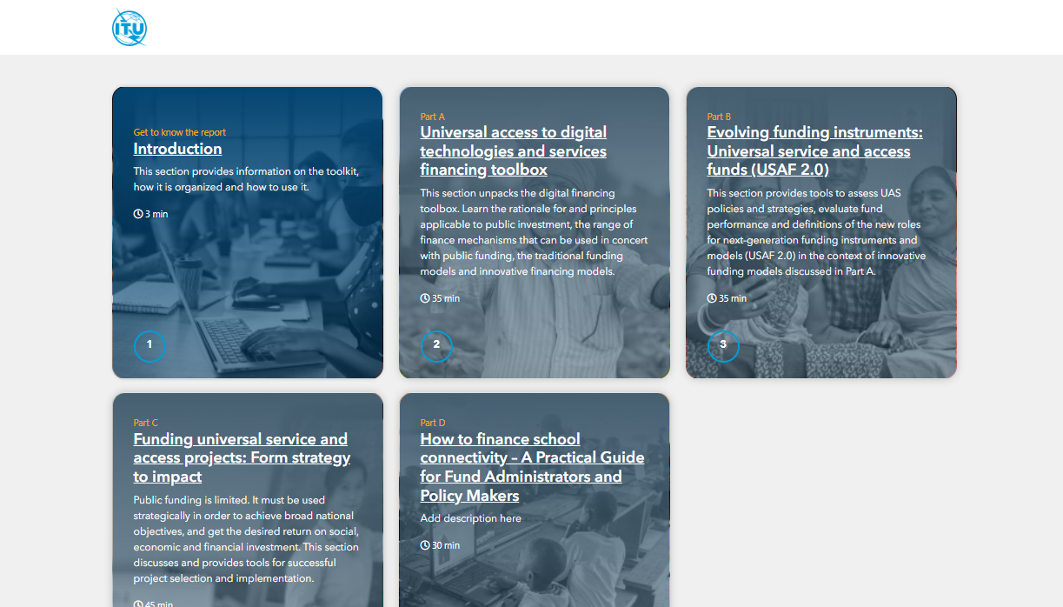
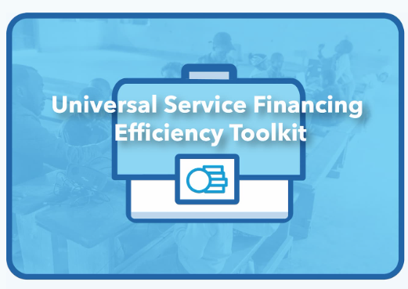
Nancy Sundberg, Senior Programme Officer ITU/BDT

Slide 2
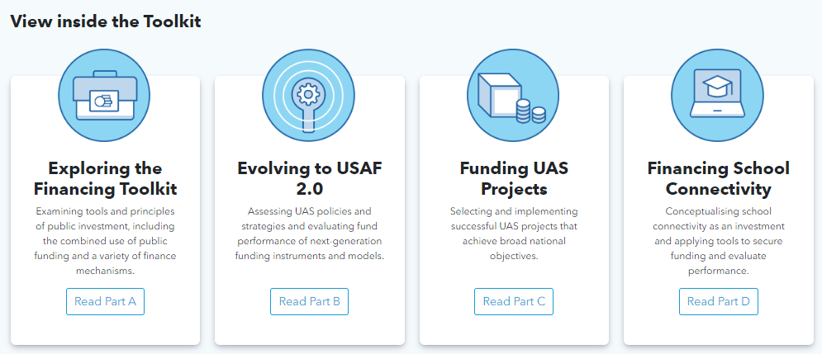
How is the Toolkit Organized?

Slide 3
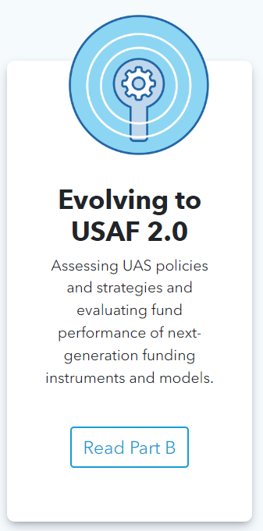

Slide 4
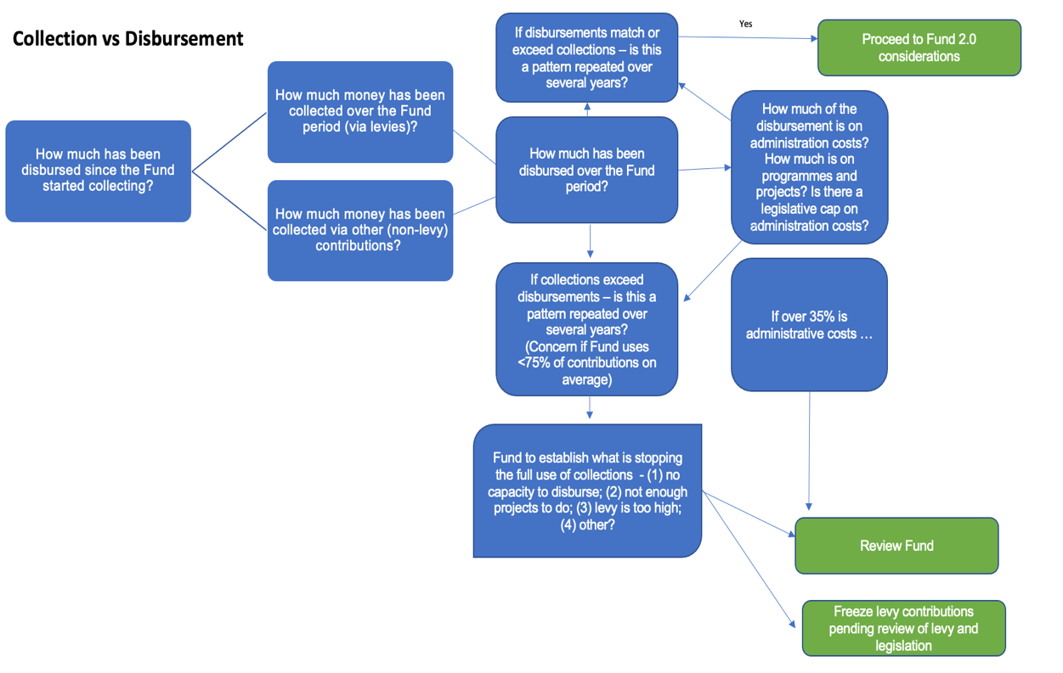
Intuitive decision making
Universal Service Financing Efficiency Toolkit | Beta

Slide 5
New Roles for USAF 2.0
Innovative Funding Models
1. Subsidies and Grants (traditional)
3. Community Broadband networks
4. Blended Financing
5. Fund of Funds and Co-Investment
2. Demand Aggregation and Anchor Tenant models
USAF 2.0 Potential Funding Tools

Slide 6
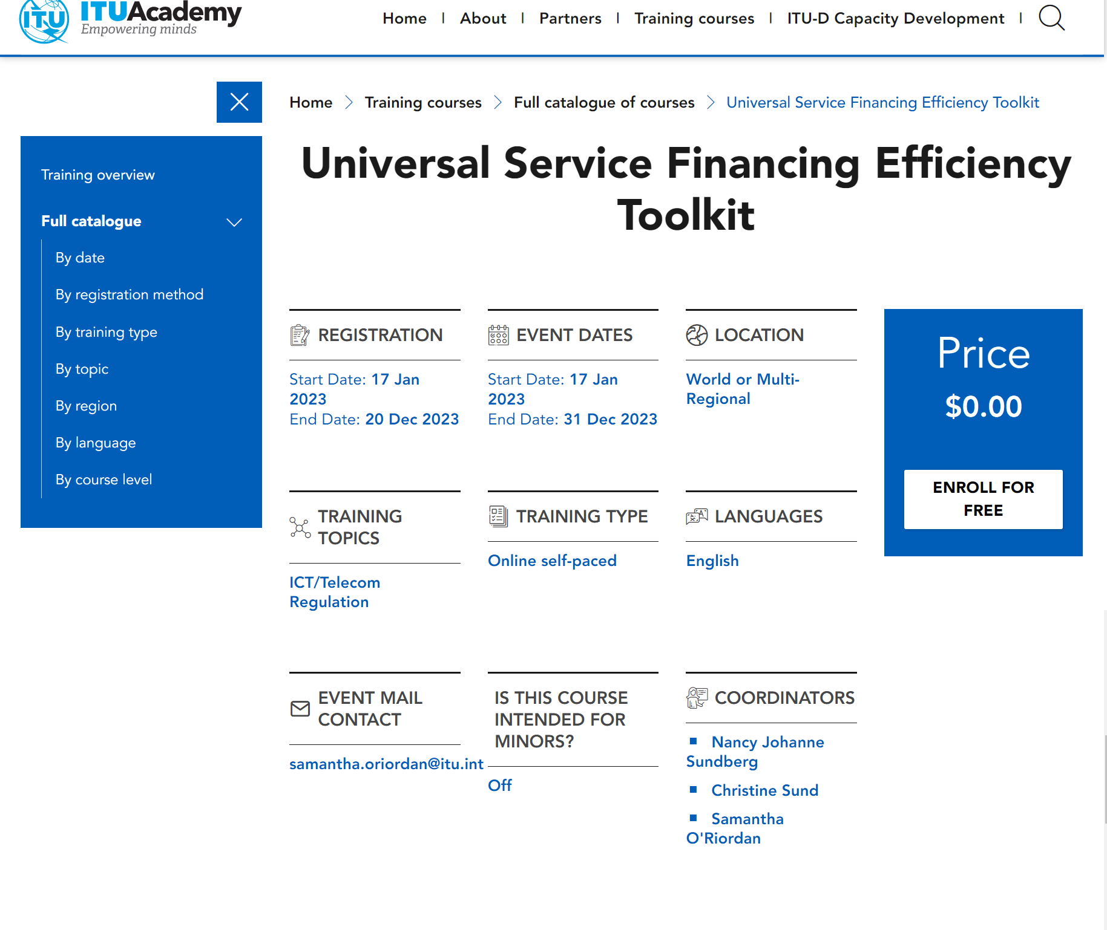
https://academy.itu.int/training-courses/full-catalogue/universal-service-financing-efficiency-toolkit-0

Slide 7
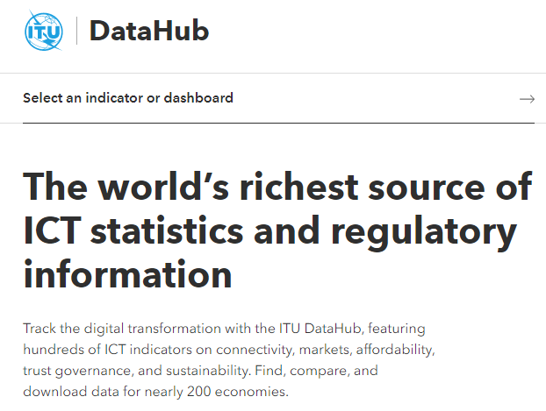
Universal Service Policies ITU DataHub
The ITU DataHub is the world’s richest source of ICT statistics and regulatory information
It features hundreds of ICT indicators on connectivity, affordability, markets, governance, trust and sustainability for nearly 200 countries.
It counts with data from ICT Statistics surveys, ITU Regulatory Survey and ITU Tariff Policies Survey
Carmen Prado-Wagner, Senior Programme Officer ITU/BDT

Slide 8
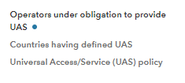
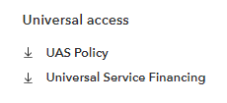
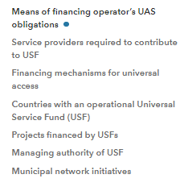
Universal access structure in the ITU DataHub

Slide 9
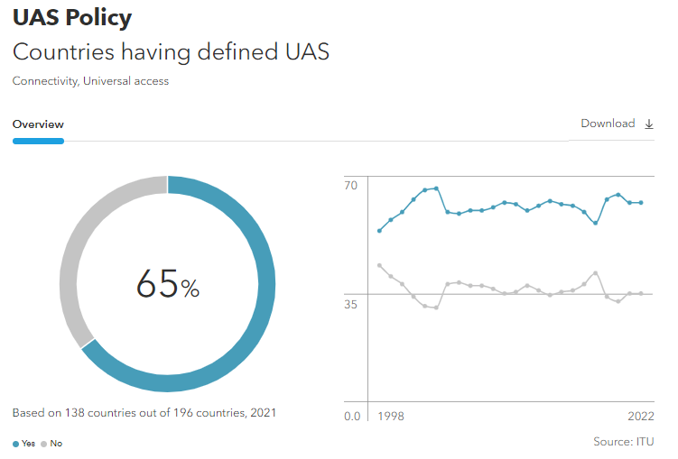
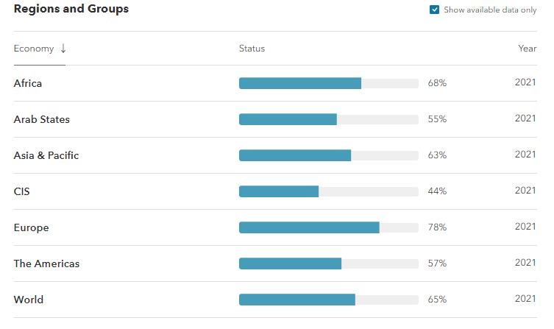
Universal Access/Service (UAS) policy
Source: https://datahub.itu.int/

Slide 10
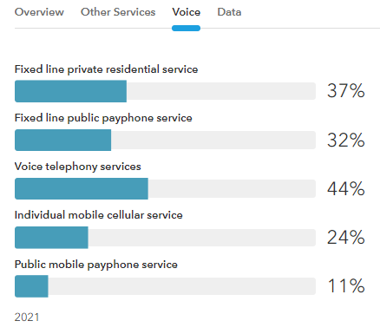
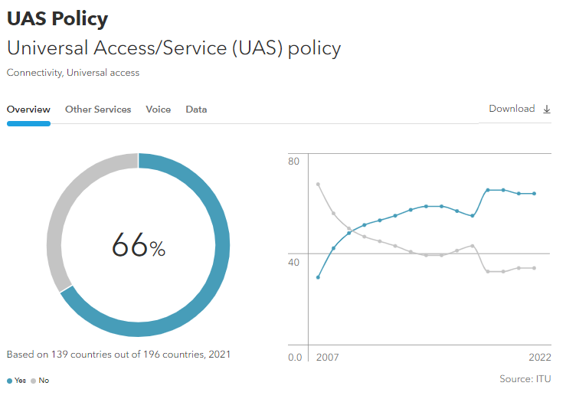
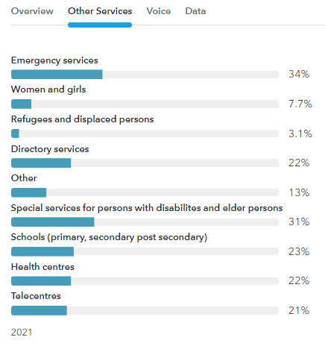
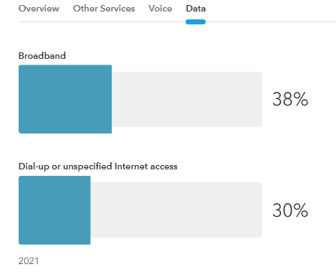
Universal Access/Service (UAS) definition
Source: https://datahub.itu.int/

Slide 11
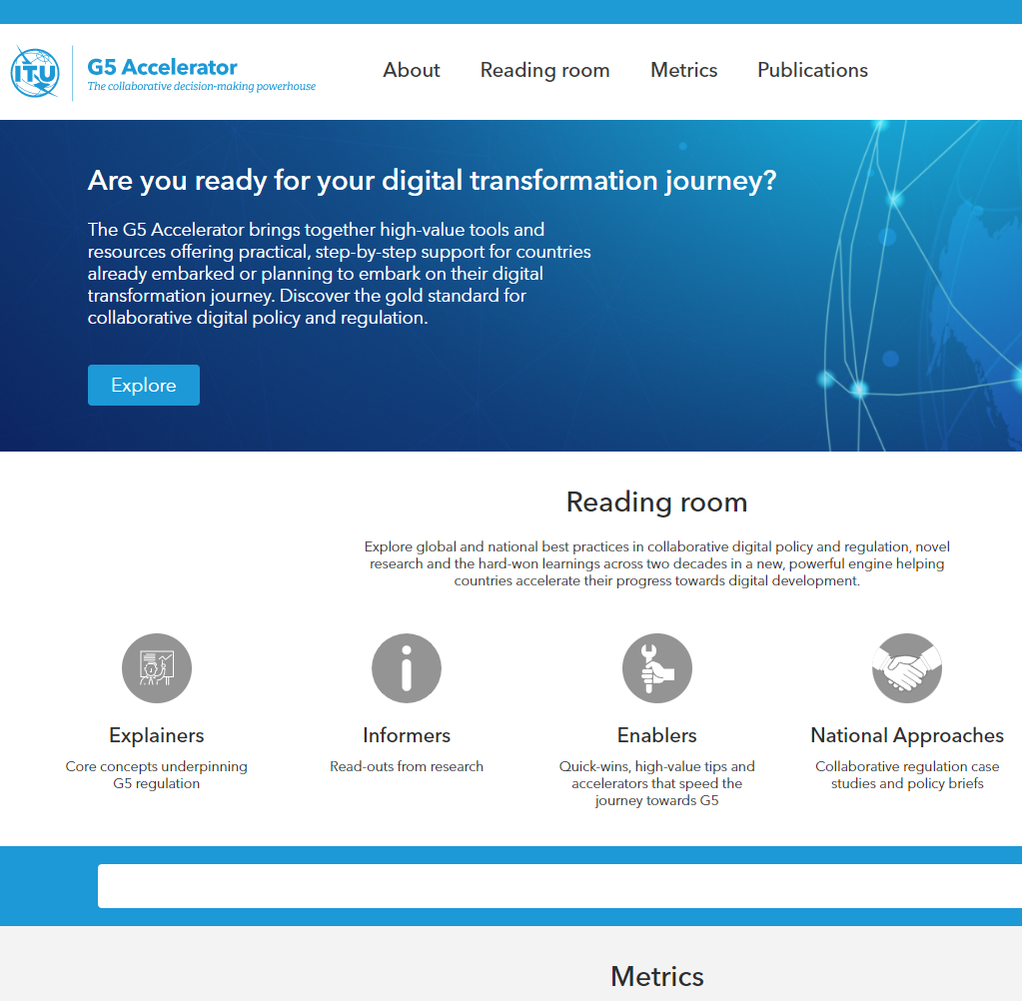
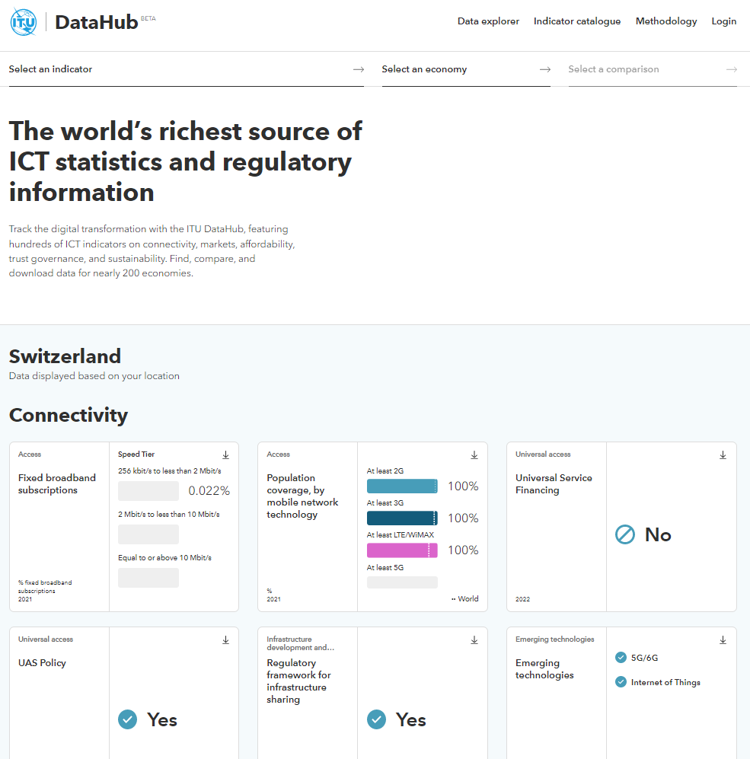
Digital Policy & Regulation
Data to inform decisions making &
track growth
Share your experiences and see what works and where
ITU DataHub
G5 Accelerator
Digital Regulation Platform​
ICT Regulatory Tracker
G5 Benchmark
ICT Policy Impact Lab
Global Symposium for Regulators (GSR-23) Egypt, 5-9 June 2023 – JOIN US!
ITU Regional Economic Dialogue for the Americas Region (RED-23), Costa Rica, 25-29 September 2023
ITU Digital Ecosystem Portal
ITU Infrastructure Development and Connectivity Portal
Regulatory Associations Portal
Research on best practices related to all current and future challenges
Opportunities of broadband, regulation of 5G, digital identity, ICT infrastructure, ICT investment needs…
Digital Regulation Platform
www.itu.int/TREG

Slide 12
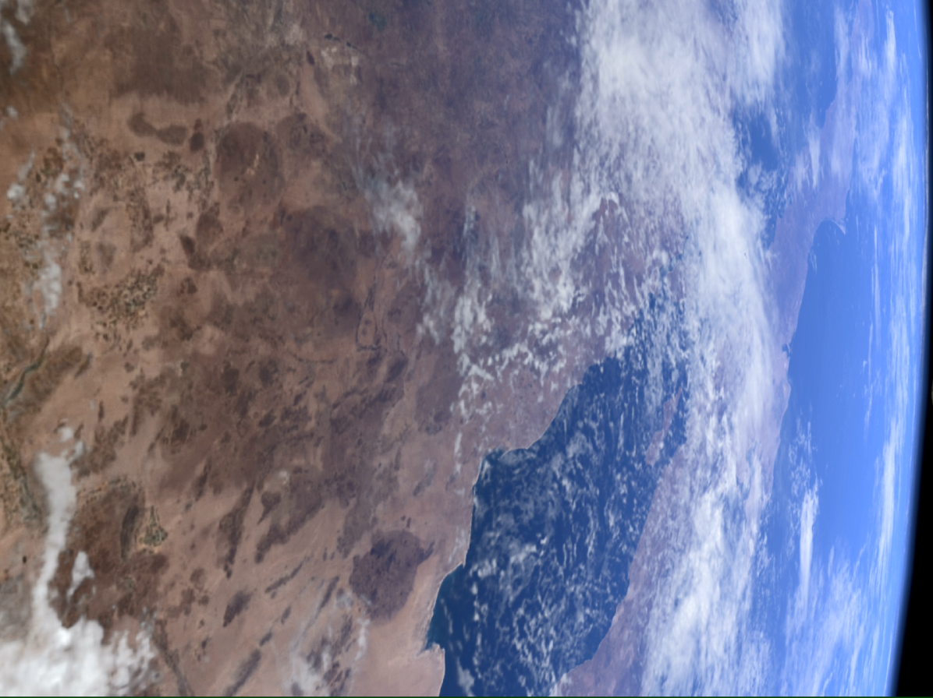
Thank you!
Join the conversation
#RegulationMatters
@ITUDevelopment
www.itu.int/TREG

